Slide 1


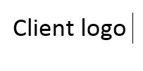

Inventory Management System (IMS)
Business Document Release date: 15/05/25
Author: Anshika Shukla

Slide 2
Design Document Contents
Status Quo and Client Requirement
Stakeholder Identification & Analysis
Business Process Mapping & Requirements Gathering
User Stories & Use Cases
Functional Prototyping & Wireframes
Test Cases & Acceptance Criteria
Communication Plan & Project Timeline
Sprint Timelines and development kick off
Production Deployment and Post UAT
Go – Live
Server Maintenance Activity and Rollback Plan (if applicable)
Client Confidential 2025. For authorized use only. (Stamp)

Slide 3
1. Status QUO
You are hired as a Business Analyst at a software development company that specializes in building custom software solutions for clients in the retail industry.
The company is working on a new project to build an Inventory Management System (IMS) for a client who has multiple retail stores. The client has expressed concerns about inefficient inventory tracking and the lack of integration between their existing sales system and warehouse management system. They want a unified solution that provides real-time inventory visibility, automated stock replenishment, and streamlined reporting.
Your task is to gather requirements, analyze the business needs, and help design the solution that meets the client’s expectations.
Client Requirement
Client Confidential 2025. For authorized use only. (Stamp)

Slide 4
2. Stakeholder identification List
Client’s Team –
Product Owner/Business Analyst
Store Managers
Retail Chain Executives
Warehouse Staff :
Procurement team included
Any Sponsor involved*
Any Solution Consultant*
IT Team
Finance and Accounts Team
Acting/Associate Directors *
Direct receivers from SYMB’s Team –
Product Owner/Business Analyst
Product/Project Manager
Development Team
API Developers*
Full Stack Developers*
Front/Backend Team*
* - Delighters; Good to have; If applicable
Client Confidential 2025. For authorized use only. (Stamp)

Slide 5
Stakeholder ANALYSIS
RACI Matrix for IMS Project – SYMB Technologies
Tasks / Deliverables | Client (Retail Owner) | Store Managers | Warehouse Staff | IT Team (Client) | Dev Team (SYMB) | Business Analyst (Anshika) | Project Manager
Requirement Gathering | A | C | C | C |  | R | I
Process Mapping | C | C | C |  |  | R | I
Finalizing Business Requirements Document (BRD) | A | I | I | C |  | R | C
Wireframes & Prototyping | I | C |  |  | C | R | A
System Design Approval | A | I | I | C | C | R | C
API Integration Planning | I |  |  | C | R | A | C
Development of IMS |  |  |  |  | R | C | A
UAT Test Case Preparation |  |  |  |  |  | R | C
UAT Execution | A | C | C | I | C | R | A
Go-Live Support | A | C | C | C | R | C | A
Status Reporting | I | I | I | I |  | R | A
R – Responsible; A – Accountable; C – Consulted; In- Informed
Client Confidential 2025. For authorized use only. (Stamp)

Slide 6
Stakeholder Communication Strategy
Stakeholder | Frequency | Method | Deliverables
Client & Store Managers | Weekly | Email + Meetings | Progress reports, demos
IT Team | Bi-weekly | MS Teams/Zoom | Tech documentation, integration plans
Warehouse Team | As needed | On-site visits | Process observations
Dev Team | Daily Standups | Jira + Teams Meet | Task status, blockers
Client Confidential 2025. For authorized use only. (Stamp)

Slide 7
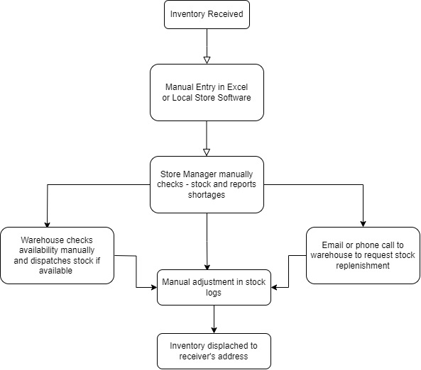
3. BUSINESS PROCESS : AS – IS
Identified Pain Points –
No Real-Time Visibility across stores or central systems.
Manual Data Entry = High error rates.
No Integration between store sales & warehouse.
Delay in Stock Replenishment = Stockouts and no stock signaling.
No Auto-Triggers for low stock alerts.
Reporting is slow and inaccurate due to Excel-based logs.
Diagram exported through Draw.io
Client Confidential 2025. For authorized use only. (Stamp)

Slide 8
BUSINESS GOALS (TO-BE) AND PROJECT SCOPE
Objectives -
Provide real-time inventory visibility across all retail locations. (M)
Enable automated stock replenishment based on defined rules. (M)
Integrate sales and warehouse systems for seamless communication. (M)
Improve reporting efficiency to support data-driven decisions. (M)
Reduce stockouts, overstocks, and manual errors. (S)
Order status and automatic updates (S)
Error Log Portal for Failed Inventory status (C)
Monthly Report buildup (W)
* - MoSCoW method to be followed here.
M – Must Have; S – Should have; C – Could have; W – Would have
In Scope -
Real-time inventory tracking per SKU, per store
Automated replenishment logic
Sales and warehouse system integration
Inventory dashboard & reports
User access control based on roles
Out of Scope:
Development of POS system
Integration with third-party logistics (3PL)
Hardware procurement (barcode scanners, tablets)
Client Confidential 2025. For authorized use only. (Stamp)

Slide 9
FUNCTIONAL AND NON-Functional REQUIREMENTS
Functional Requirements in consideration -
System shall allow real-time inventory updates from all stores and warehouses.
System shall trigger auto-replenishment when quantity falls below reorder level.
System shall allow manual adjustments with reason logging.
System shall provide low-stock alerts to store managers.
System shall provide overstock alerts based on thresholds.
System shall integrate with the existing sales system API.
System shall support role-based access (admin, store manager, warehouse staff).
System shall maintain historical logs of stock movements.
System shall generate customizable reports by date, location, or SKU.
System shall support bulk import/export of inventory data in Excel format.
Non - Functional Attributes to Flow -
Performance: Must handle updates from 50+ stores with <2s latency.
Availability: 99.9% uptime expected.
Scalability: Should support up to 500 SKUs/store and 100 concurrent users.
Security: Role-based access, two-factor authentication for admin users, encrypted data transmission.
Usability: UI should be clean, mobile-responsive, and require minimal training.
Client Confidential 2025. For authorized use only. (Stamp)

Slide 10
Assumptions and Constraints
Assumptions -
Client will provide access to existing sales and warehouse APIs.
Stores have basic internet connectivity and scanning devices.
All users are familiar with basic digital interfaces.
* - To be discussed with Client on Call and taken in written.
Constraints -
Project timeline: 3 months.*
Budget: ₹12–15 lakhs for Phase 1. *
System must work within existing infrastructure (cloud-based preferred, but hybrid if required).
Data migration from Excel will require validation phase.
Client Confidential 2025. For authorized use only. (Stamp)

Slide 11
4. USER STORIES
Format Followed - As a..I want..so that
As a Store Manager, I want to view real-time inventory levels across all SKUs, so that I can prevent stockouts and restock proactively.
As a Warehouse Staff, I want to receive automated replenishment requests, so that I can fulfill store needs without delays.
As a Sales Associate, I want to be alerted when a product is low in stock, so that I can inform customers and recommend alternatives.
As an Admin, I want to define minimum and maximum stock thresholds for each SKU, so that the system can auto-manage replenishment efficiently.
As a technical Staff member, I want to be able to detect API fallbacks and error logs, so that I can manually push or pull the required data.
As a Regional Manager, I want to download and analyze inventory reports by store and category, so that I can make informed stocking and budgeting decisions.
Client Confidential 2025. For authorized use only. (Stamp)

Slide 12
4. USER Case 1 – FULLFILMENT OF ORDER via AUTO TRIGGER
Actors:
Store Manager (indirectly)
IMS System
Warehouse Staff
Alternative Flows:
If item is out of stock in warehouse → System flags it and sends alert to store manager.
If multiple stores request the same SKU → System prioritizes based on urgency or historical sales.
Preconditions:
Minimum and maximum thresholds are set for each SKU.
IMS is integrated with the store’s sales data and tracks stock in real time.
Main Flow:
IMS receives live sales data.
Stock quantity for SKU X drops below its minimum threshold.
System auto-generates a replenishment order.
Order is sent to the warehouse interface.
Warehouse staff is notified of the request.
Postconditions:
Replenishment order is logged in the system and marked “Pending.”
Inventory movement is tracked from warehouse to store once fulfilled.
Client Confidential 2025. For authorized use only. (Stamp)

Slide 13
4. USER Case 2 – Low-Stock Alert Generation
Actors:
Sales Associate
IMS System
Alternative Flows:
If stock is already 0 → System displays “Out of Stock” with substitute suggestions (if configured).
If item is available at a nearby store → Suggest inter-store transfer or customer pickup option.
Preconditions:
SKU-level alert thresholds are already configured.
Sales associate is logged into the POS system connected to IMS.
Main Flow:
Sales associate scans SKU X at checkout.
IMS checks stock level for that SKU.
If stock ≤ alert threshold, system displays a “Low Stock” warning.
Sales associate is informed and can notify customer or recommend alternatives.
Postconditions:
Alert is logged with timestamp and SKU ID.
Optional trigger for manager to review or adjust thresholds if needed.
Client Confidential 2025. For authorized use only. (Stamp)

Slide 14
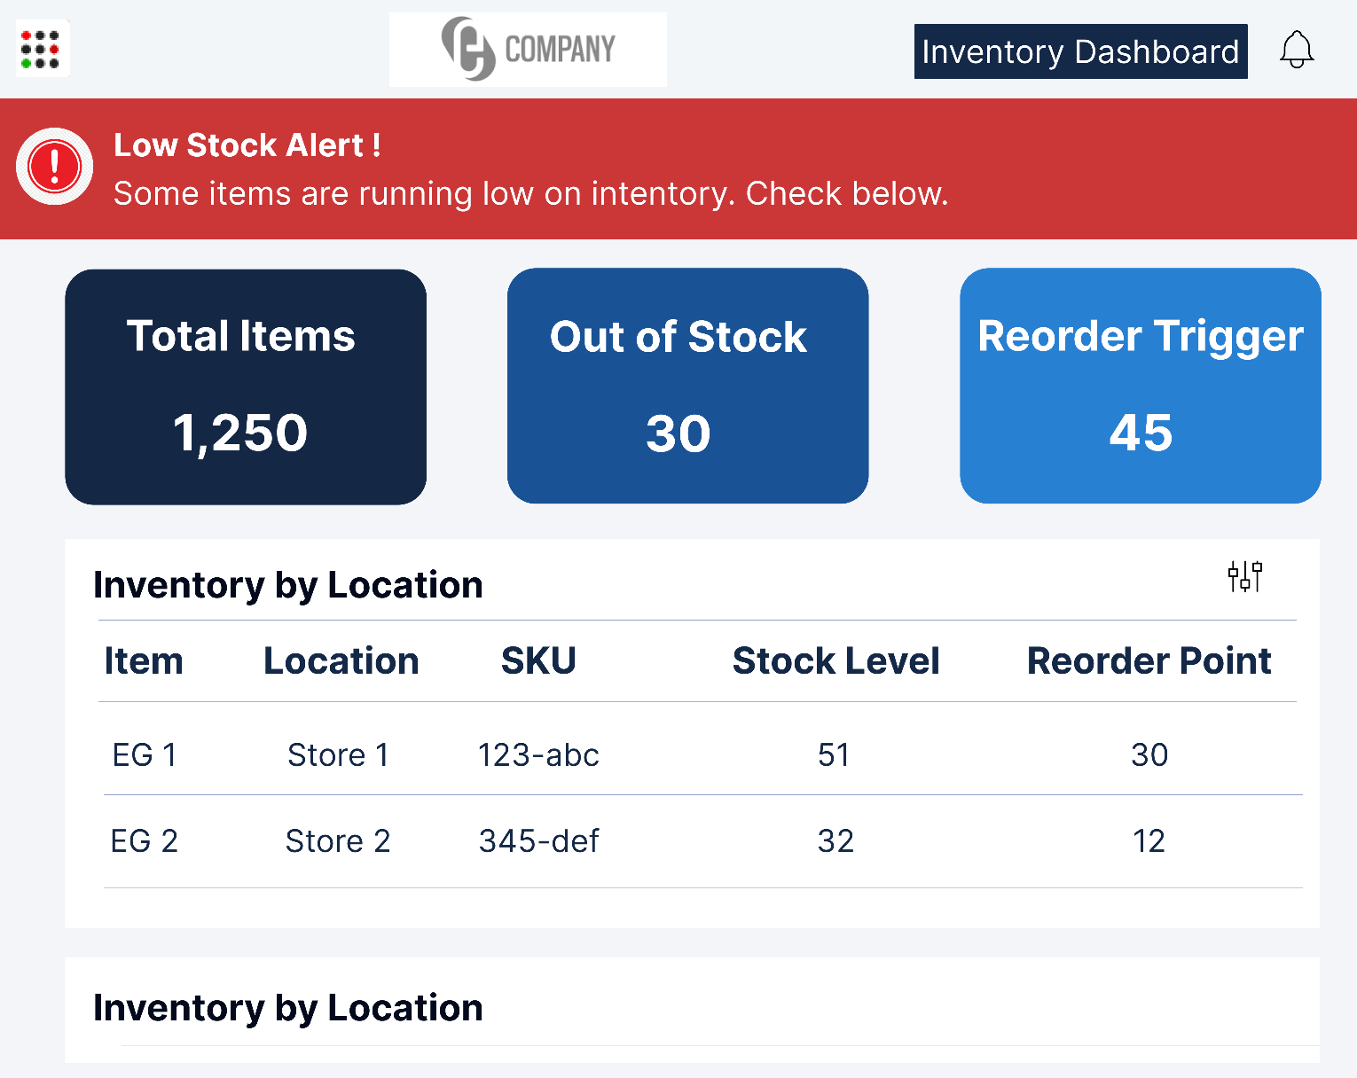
5. Prototype 1 – THE INVENTORY DASHBOARD
Note – To open the live wireframes, go the Figma links provided on the last slide.
Inventory Dashboard – Summary
Header Bar:
Title: "Inventory Dashboard"
Right side: Dashboard tab and notification bell icon
Alert Section:
Red banner with (caution) icon
Message: “Low Stock Alert – Some items are running low on inventory.”
Key Metrics (Cards):
Total Items: 1,250
Out of Stock: 30
Reorder Triggered: 45
Inventory Table (By Location): Columns: Item, Location, SKU, Stock Level, Reorder Point
Shows multiple products with stock levels and reorder points across store locations.
Client Confidential 2025. For authorized use only. (Stamp)

Slide 15
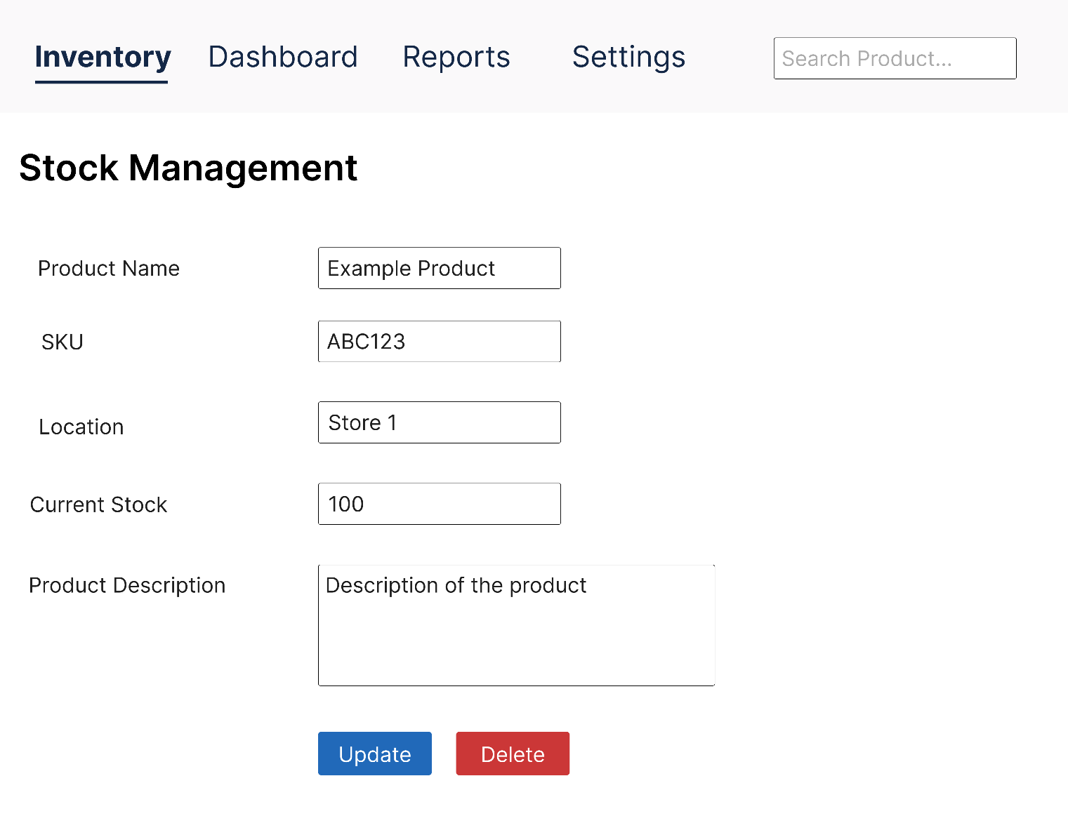
5. Prototype 2 – THE Stock Management interface
Note – To open the live wireframes, go the Figma links provided on the last slide.
Stock Management Interface – Summary
Top Menu Bar:
Sections: Inventory, Dashboard, Reports, Settings
Search bar for quick product lookup
Main Form:
Product Name: Example Product
SKU: ABC123
Location: Store 1
Current Stock: 100
Description: Editable text area for product details
Actions:
Update button (blue): Save stock changes
Delete button (red): Remove product entry
Client Confidential 2025. For authorized use only. (Stamp)

Slide 16
6. TEST CASES :– CASE 1 ; ON Auto-Replenishment Trigger
Test Scenario:
When the stock level of a SKU falls below the defined minimum threshold, the system should automatically generate a replenishment request.
Steps to follow :
Log into the IMS as Admin.
Set minimum threshold for SKU "ABC123" to 5 units.
Simulate sales until stock drops to 4 units.
Check if the system triggers an automatic replenishment.
Validate that the order appears in the warehouse queue.
Expected Result:
A purchase/replenishment order is auto-created and sent to the warehouse interface. Store Manager gets notified.
Check Criteria:
Pass if a replenishment order is created within 5 seconds of threshold breach.
Fail if no order is generated or delayed beyond 10 seconds.
Client Confidential 2025. For authorized use only. (Stamp)

Slide 17
6. TEST CASES :– CASE 2 ; ON Low Stock Alert
Test Scenario:
The system should alert sales associates if a scanned item’s quantity is at or below the low stock alert level.
Steps to follow :
Log into the POS connected to IMS.
Configure alert level for SKU "XYZ789" at 3 units.
Update stock of SKU to 3 units.
Scan the SKU on POS terminal.
Observe the alert response.
Expected Result:
A pop-up warning appears on the POS screen with “Low Stock” notice and quantity.
Check Criteria:
Pass if the alert is displayed with real-time count and warning message.
Fail if no alert appears, or count is incorrect.
Client Confidential 2025. For authorized use only. (Stamp)

Slide 18
6. TEST CASES :– CASE 3 ; Role-Based Access Control
Test Scenario:
Verify that only authorized users (Admin) can adjust inventory quantities, while Store Managers can only view.
Steps to follow :
Log in as Store Manager and attempt to update stock for SKU “1234567-001”.
System should prevent edit and show permission message.
Log in as Admin and perform the same action.
Admin should be allowed to change the quantity.
Expected Result:
Admin can edit stock; Store Manager gets a read-only view.
Check Criteria:
Pass if Store Manager is blocked and Admin is granted access.
Fail if Store Manager can edit or Admin is restricted.
Client Confidential 2025. For authorized use only. (Stamp)

Slide 19
6. ACCEPTANCE CRITERIA FOR IMS
Functional -
System tracks and updates inventory in real time.
Auto-replenishment is triggered for all SKUs when thresholds are breached.
Sales and warehouse systems are successfully integrated via API.
Low stock alerts function as per SKU-level configuration.
Stock logs are created for every add/edit/delete activity.
User roles are fully enforced — Admin, Store Manager, Warehouse Staff.
Inventory reports can be generated and exported (PDF/Excel).
Non-Functional –
IMS handles at least 100 concurrent users with <2 seconds latency.
System uptime is proven to be 99.9% over a 2-week UAT period.
Access is secure — two-factor authentication for Admins, encrypted data storage.
Client Confidential 2025. For authorized use only. (Stamp)

Slide 20
7. Communication Plan – IMS Project
Effective communication is critical to ensure alignment between stakeholders and project teams, reduce delays, and manage risks proactively.
Stakeholder Communication Strategy :
Stakeholder | Communication Purpose | Frequency | Method | Reports/Deliverables
Client (Retail Owner) | High-level progress, key decisions, approvals | Weekly | Email + Zoom | Executive summary, feature status, issue log
Store Managers | Feedback on system usability, pain points | Bi-weekly | Group Calls / Surveys | Feedback reports, walkthrough summaries
Warehouse Staff | Clarifications on inventory flows, usability issues | Fortnightly | On-site Sessions | Task lists, inventory flow drafts
Client’s IT Team | Integration scope, API testing updates | Weekly | Email | API documentation, integration updates
Internal Dev Team | Task updates, blockers, sprint tracking | Daily (Stand-ups) | Jira + MS Teams | Sprint board, burndown charts, blockers log
SYMB Project Manager | Status reviews, risk management | Twice a week | Zoom + Dashboard | Risk log, issue tracker, timeline updates
Business Analyst (Anshika) | Central coordinator for all communication | Ongoing | All Channels | Maintains minutes, BRDs, action item logs
Client Confidential 2025. For authorized use only. (Stamp)

Slide 21
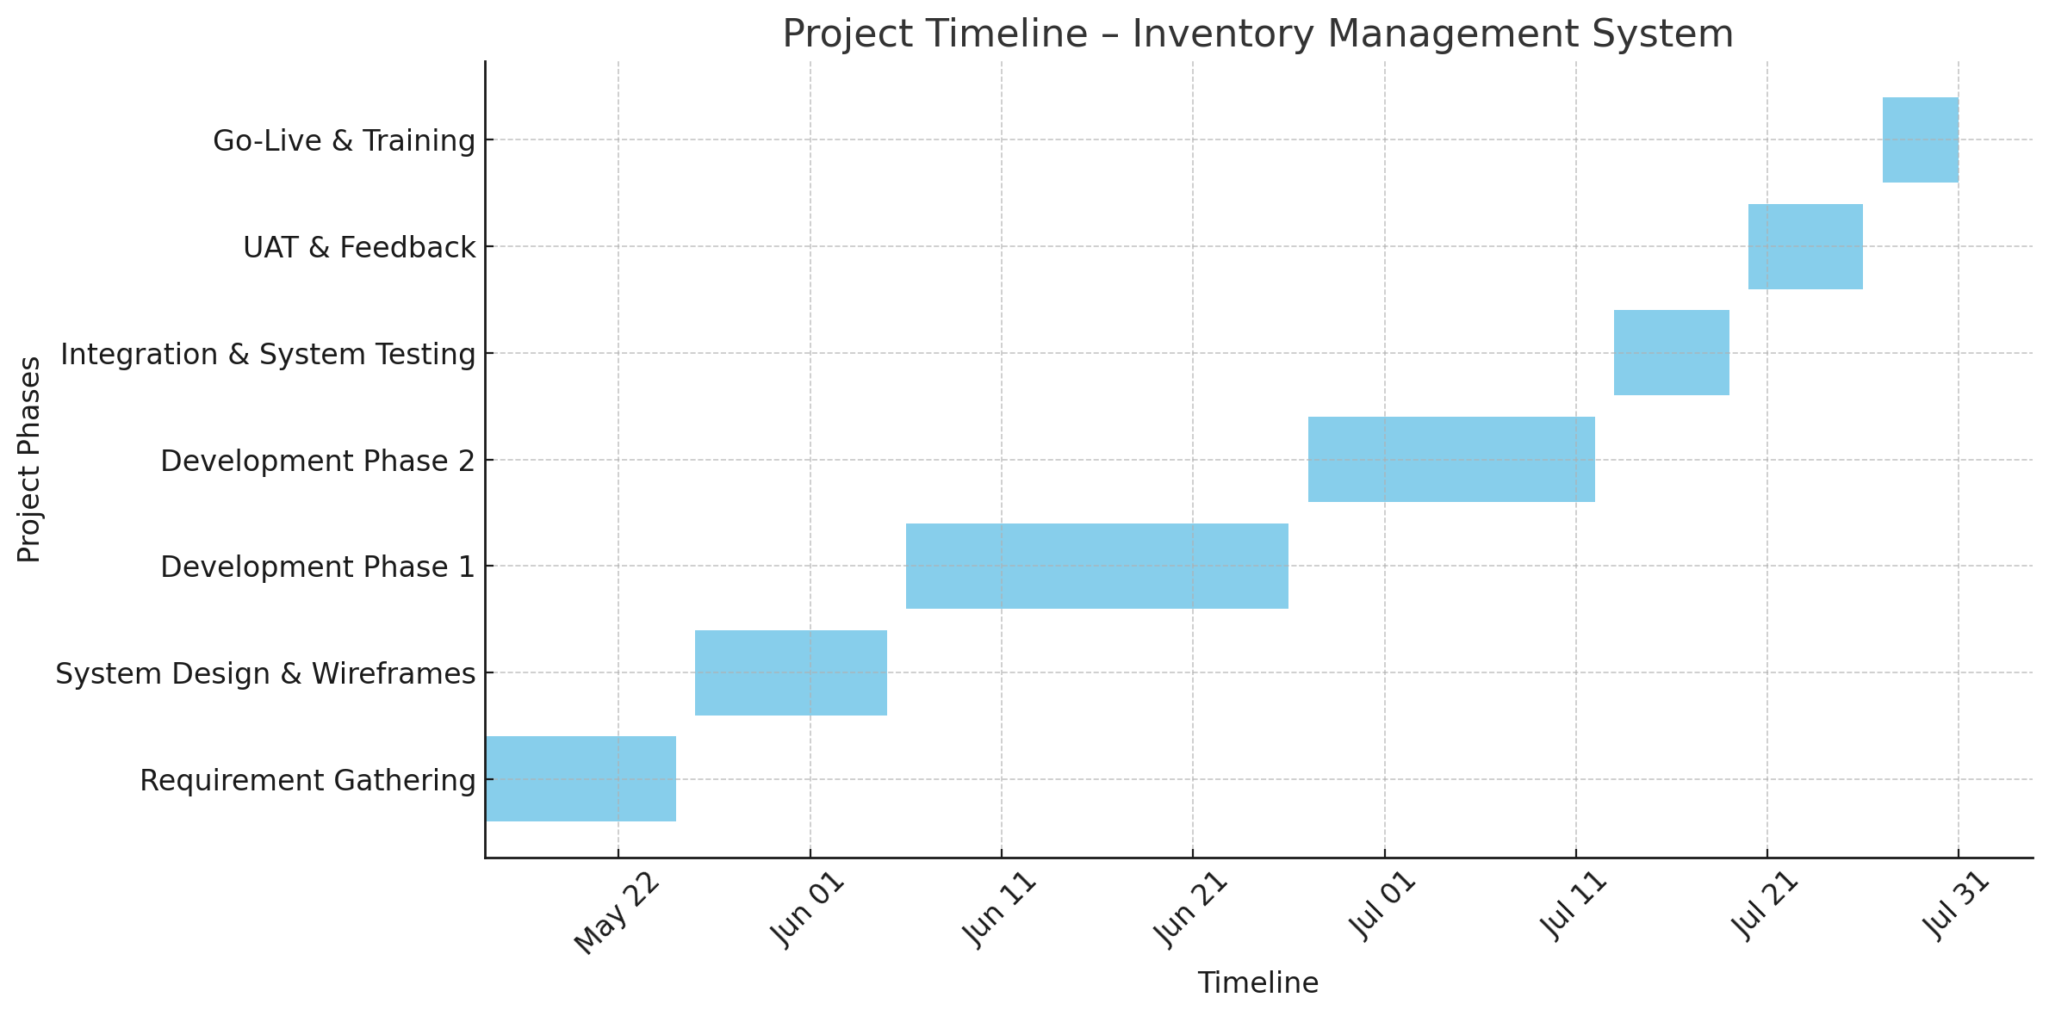
8. Project Timeline – Development KICK OFF
Note – The dates mentioned in this chart are entirely fictional and based according to the previous information present in the document. The below depicted image was created using excel. (the origional Gantt chart’s excel sheet has been attached to mail)
Client Confidential 2025. For authorized use only. (Stamp)

Slide 22
9. PRODUCTION DEPLOYMENT AND POST UAT
POST PRODUCTION NOTES –
Capture UAT feedback and incorporate any critical changes
Ensure sign-off from all stakeholders
Perform final regression testing after UAT fixes
Finalize training documents and user manuals
Prepare Go-Live readiness checklist
Validate that all acceptance criteria are met
Conduct a pre-deployment dry run
Confirm data backup & migration is complete
Client Confidential 2025. For authorized use only. (Stamp)

Slide 23
SERVER MAINTAINANCE ACTIVITY AND ROLLBACK PLAN
Activity | Description
Scheduled Downtime Planning | Communicate maintenance windows in advance to all users
System Backup Validation | Confirm data is backed up before patches/updates
Patch Management | Document when OS, DB, or application-level patches are applied
Monitoring Protocols | Mention tools/logs for server health monitoring (e.g., CPU, memory, disk usage)
Load Testing Readiness | Ensure servers can handle peak expected loads post-deployment
Server Access Control Review | Periodic check on admin/root access, especially after release cycles
Environment Sync | Ensure staging/UAT mirrors production to avoid surprises post-deploy
Audit Logs Documentation | Ensure server actions are traceable (login attempts, system changes)
Client Confidential 2025. For authorized use only. (Stamp)

Slide 24
All links and everything
Thanks for going through my project ! Mentioned are the Figma links -
https://www.figma.com/proto/2d7hbiLjBr9ogBona53Tyg/Untitled?node-id=2009-70&t=hgAH0EK3SWLSoy2h-0&scaling=scale-down&content-scaling=fixed&page-id=2009%3A69
https://www.figma.com/proto/2d7hbiLjBr9ogBona53Tyg/Untitled?node-id=2009-132&t=hgAH0EK3SWLSoy2h-0&scaling=scale-down&content-scaling=fixed&page-id=2009%3A69
Draw.io -
Feel free to reach out to me at –
anshikashukla2520@gmail.com
+91-6263095335
Client Confidential 2025. For authorized use only. (Stamp)

